Slide 1

Comparing to human-level performance
Surpassing human- level performance
deeplearning.ai

Slide 2
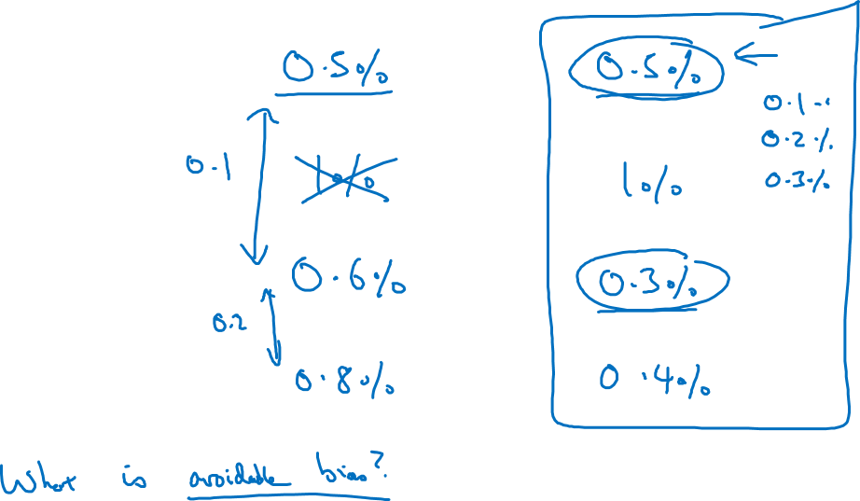
Surpassing human-level performance
Team of humans
One human
Training error
Dev error

Slide 3
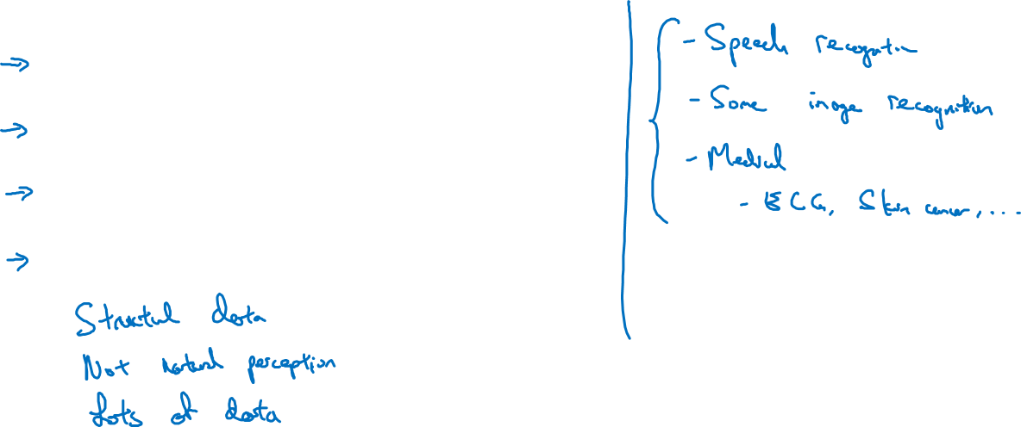
Problems where ML significantly surpasses human-level performance
Online advertising
Product recommendations
Logistics (predicting transit time)
Loan approvals

